Slide 1
Gadgets

Slide 3
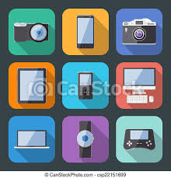
A gadget is a mechanical device or any ingenious article.
Gadgets are sometimes referred to as gizmos

Slide 4
Gadgets
Peripherals are input, output, and storage devices that are connected to a computer externally.
These gadgets such as scanners, digital cameras, and CD drives allow a computer to perform more function and increase the value of computers in businesses, schools, and homes.

Slide 5
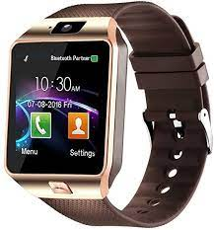
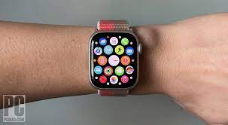
Examples of Gadgets:
Smart Watch
A smartwatch is a wearable computer in the form of a watch;
modern smartwatches provide a local touchscreen interface for daily use

Slide 6
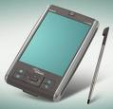
Handheld Computers
A mobile (also known as cellphone , handheld device, handheld computer, "Palmtop" or simply handheld) is a pocket-sized computing device, typically having a display screen with touch input or a miniature keyboard.
In the case of the personal digital assistant (PDA) the input and output are combined into a touch-screen interface.

Slide 7
Digital Video Cameras
A digital video camera (DVCAM) is a device that captures motion picture information from live environments, encoding it into data that can be decoded

Slide 8
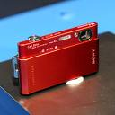
Digital Cameras
A digital camera (also digicam or camera for short) is a camera that takes video or still photographs, or both, digitally by recording images via an electronic image sensor.

Slide 9
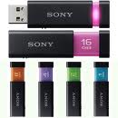
U.S.B (Flash Drive)
A USB flash drive consists of flash memory data storage device integrated with a USB (Universal Serial Bus)
USB flash drives are typically removable and rewritable.

Slide 10
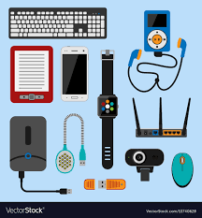
Thank YOu .

