Slide 1
History of Computers

Slide 2
Who invented computers?
No one person invented the computer. There were many inventions over hundreds of years that led to the computers we know today.

Slide 3
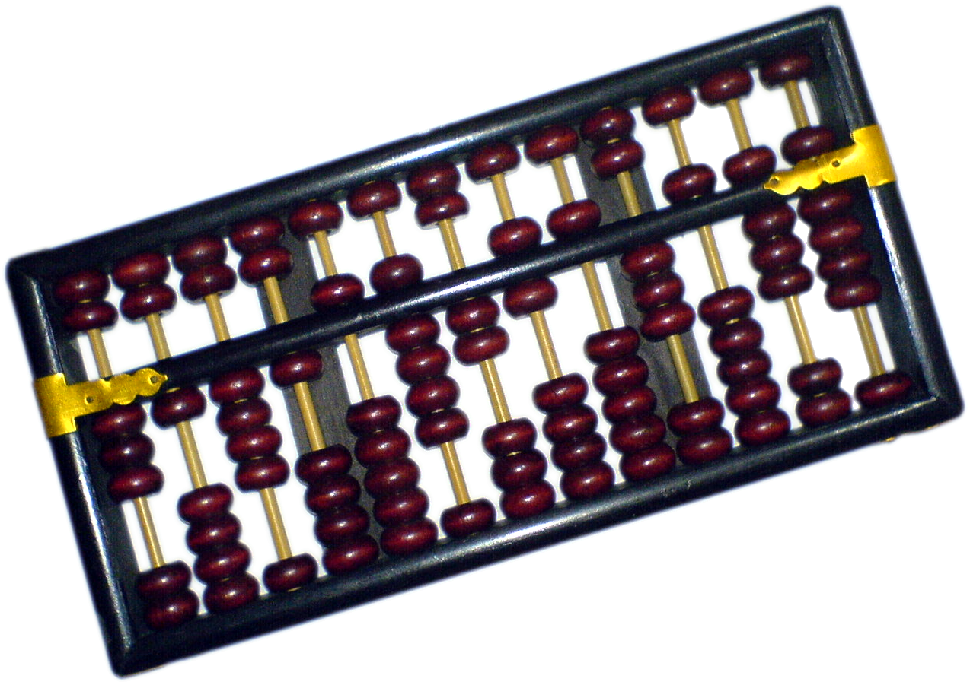
The Abacus
Thousands of years before electronic computers were invented, people in China, the Middle East, and Greece used the abacus to add and subtract large numbers.

Slide 4
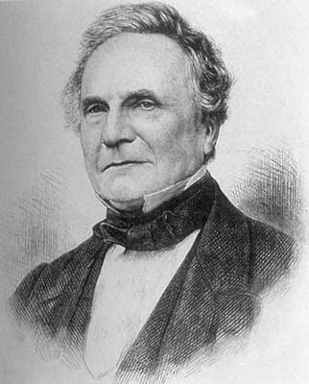
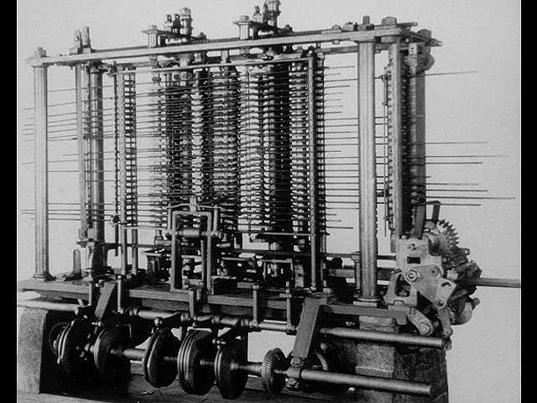
Steam Calculator
About one hundred eighty five years ago in England, Charles Babbage invented an automatic calculator powered by steam. Even though Babbage worked on his machines for many years, he was never able to build one that worked.
Charles Babbage

Slide 5
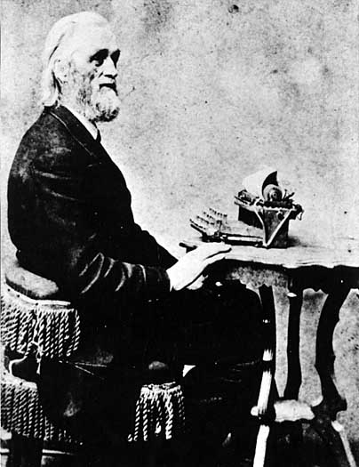

Typewriter
About one hundred thirty five years ago C.L Sholes invented a typewriter upon witch today’s computer keyboards are modeled.
C.L Sholes

Slide 6
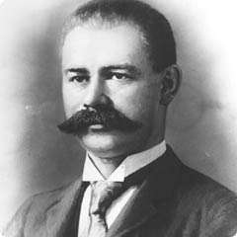
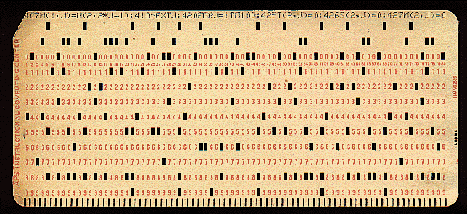
Punch Cards
About one hundred fifteen years ago an American named Herman Hollerith invented a calculator that stored data on punch cards. For more than fifty years, computer data continued to be stored in this way.
Herman Hollerith

Slide 7
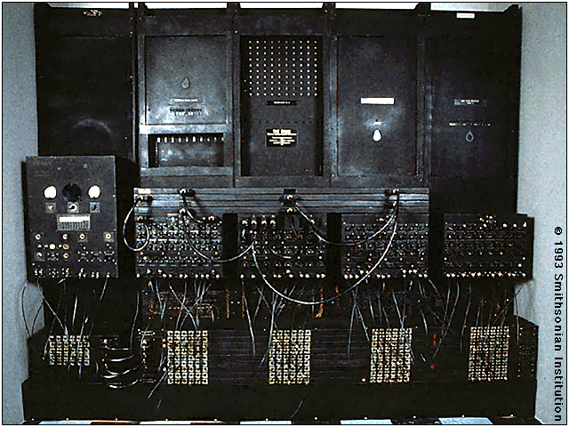
E.N.I.A.C
A computer called ENIAC (Electronic, Numerical, Integrator and Calculator) was built in the United States to help design weapons. The computer was more than eighty feet long and weighed thirty tons. It could calculate as much in two hours as one hundred scientists could do in a year.

Slide 8


Computers in Factories
About forty five years ago factories and other very large businesses began to use computers to figure out payroll, sales, and expenses. Computers also preformed specific tasks such as booking airline reservations and seat assignments. Such computers were very big and very expensive, with many costing more than one million dollars.

Slide 9

The Internet
About thirty five years ago the Internet was born when computers at four different universities were connected. For many years the Internet was used mainly by people in government and universities.

Slide 10

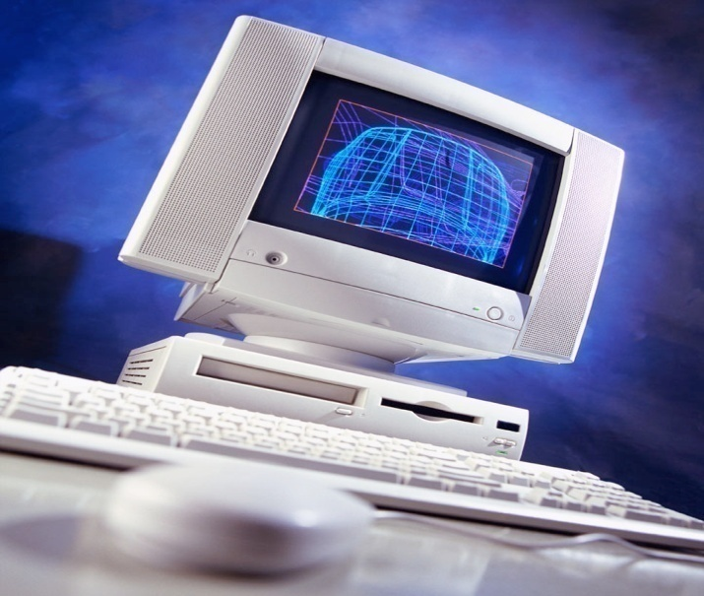
Personal computers
About twenty five years ago personal computers were introduced. These were small desktop-sized machines that stored data on tiny chips of silicon, a rock-like substance. As computers got smaller and less expensive, people in offices, schools, and homes began to use them.

Slide 11

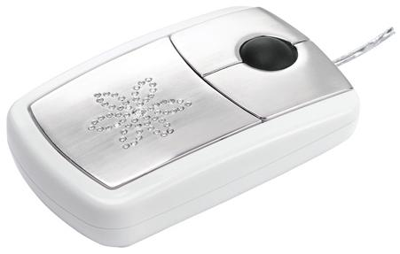
Computer mouse
About twenty years ago the computer mouse was introduced. Along with pull-down menus and icons, the mouse made personal computers easier to use.

Slide 12
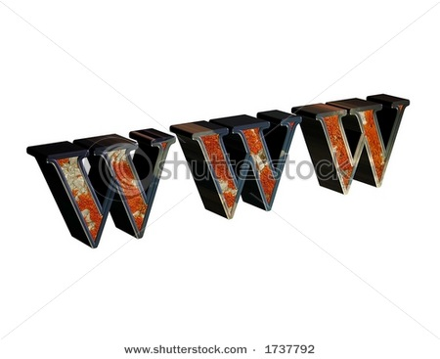

World Wide Web
About fifteen years ago hypertext links were added to internet sites. Hypertext links allowed users to jump from one site to another with a click on a link. This system of linked sites became known as the World Wide Web.

Slide 13

CD-ROMs
About fifteen years ago multimedia computers with CD-ROM drives began to sell in large numbers. CD-ROMs hold thousand of times more information than floppy disks. The large storage size allowed increase use of graphics, video, and sound.

Slide 14
Reference
www.msu.edu/course/lbs/126/lectures/Image/Babbage
www2.lr.psu.edu/ojj/courses/ist-240/reports/Spring2001/fa-cb-bc-kf
www.vyvy.org/main/sites/vyvy.org/files/abacustouched.png
avicollimecca.com/images/typewriter.jpg
www.library.wisc.edu/etext/WIReader/Images/WER0772.html
Info.biz.hr/Typo3/typo_10/dummy.3.8.0//uploads/pics/kar-100.jpg
www.farm4.static.flikr.com/3109/2866184570_a844a3404a_o.gif
www.schoolfoundations.org/documents/filelibrary/images/Money_2-070105143819.gif
SRA Tech Knowledge Level 6

Slide 15
Reference
www.Sorcejuice.com/wp-content/uploads/2008/03/factory_.jpg
Oldweb.cecm.sfu.ca/personal/Jborwein/Math419/eniac.gif
www.renew.net/images/internet-explorer.png
www.aeroxp.org
www.rso.cornell.edu/hellnic/images/stories/computer.jpg
www.ecommerce.lcs.net/computer.jpg
www.techfuels.com/attachments/cpu-components/7979d1226568526-computer-mouse-computer-mouse.jpg
www.fahad.com/pics/diamond_flower_mouse.jpg
www.istockphoto.com/file_thumbview_approve/5993928/2/istockphoto_5993928_internet-sign.jpg

Slide 16
Reference
www.thumbs.shutterstock.com-edgesuit.net/display-pic-with-logo/62864/6286411564973944/stock-photo-internet-sign-d-rendered-could-be-used-on-internet-and-advertizing-1737792.jpg
www.cited.be/images/cd-ontwikkeling.jpg

