Slide 1
History of computers
Grade -3

Slide 2
Grade - 3

Slide 3
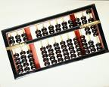
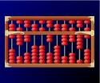
Abacus
Thousands of years before the first electronic computer, people in China, the Middle East, and Greece used abacus to add and subtract large numbers.

Slide 4
Automatic calculater
About 185 years ago in england, Charles Babbage invented an automatic calculator powered by steam. Although Babage worked on his machines for many years, he was never able to build one that worked.

Slide 5
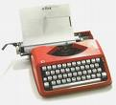
Typewriter
About 135 years ago C.L. Sholes invented a typewriter, upon which today’s computer keyboards are modeled.

Slide 6
Punched cards
About 115 years ago an American named Herman Hollerith invented a calculator that stored data on punched cards. For more than fifty years, computer data would continue to be stored in this way.

Slide 7
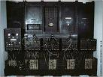
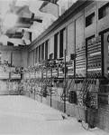
ENIAC
About 60 years ago a computer called the ENIAC (Electronic Numerical Integrater and Calculator) was built in the United States to help design weapons. The computer was more than 80 feet long and weighed 30 tons. It could calculate as much in two hours as 100 scientists could do in a year.

Slide 8
History about computers
About 45 years ago factories and other very large businesses began to use computers to figure payroll, sales, and expenses. Computers also performed specific taskes such as booking airline reservations and seat were very big and very expensive, with many costing more than one million dollars.

Slide 9
Internet
About 35 years ago the internet was born when computers at four different universities were connected. For many years the the internet was used mainly by people in government and universities.

Slide 10
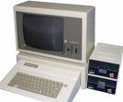
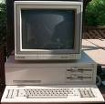
Personal computers
About 25 years ago personal computers were introduced . These were small, desktop-sized machines stored data on tiny chips of silicon, a rock-like substance. As computers got smaller and less expensive, people in offices, schools, and homes began to use them.

Slide 11
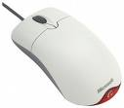
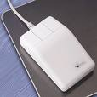
Mouse
About 20 years ago the computer mouse was introduced. Along with pull-down menus and icons, the mouse made personal computers easier to use.

Slide 12
Hypertext links
About 15 years ago hypertext links were added to Internet sites. Hypertext links allow user to jump from one site to another with a click on a link. This system of linked sites became known as the World Wide Web.

Slide 13
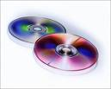
CD-ROM drives
About 15 years ago multimedia computers with CD-ROM drives began to sell in large numbers. CD-ROMs hold thousands of times more information than floppy disks. The large storage size allowed increased use of graphics, video, and sound

