Slide 2
Getting familiar with computer Basics

Slide 3


Slide 4
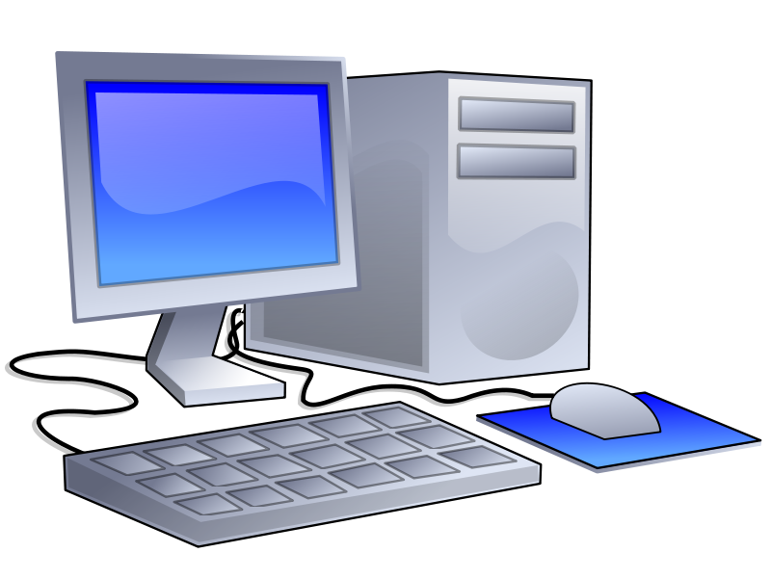
Introduction
Computer is an electronic device that is designed to work with information.

Slide 5
The computer takes information in, processes that information, and then displays the results.

Slide 6
Benefits of using a computer
These are the benefits of using a computer:

Slide 7
Speed: it allows you to perform tasks more quickly

Slide 8
Quality: the tools that come with a computer enable you to create high quality document

Slide 9
New skills: basic computer skills are often required to accomplish many daily tasks.

Slide 10
What you can do with a computer???

Slide 11
You can do many things using a computer here are only some:

Slide 12
Create documents

Slide 13
Work with numbers

Slide 14
Store large data

Slide 15
Make a movie

Slide 16
Create pictures

Slide 17
Types of computers
There are many types of computers like:
Desktop.
Notebook.
Tablet PC.
Handheld PC.
Server.
Etc…

Slide 18
Parts of a personal computer
These are the main personal computer parts:
Computer case
Monitor
Keyboard
Mouse
Printer
Speakers
Uninterruptible power supply
Game controller
Surge protector
modem

Slide 19
personal computer
Front of a personal computer
Power switch
Reset switch
Activity light
Floppy drive
CD_ROM drive

Slide 20
PORTS
There are many types of ports these are some
Monitor port
Keyboard port
Mouse port
Printer port
Serial port
USB port
Sound ports
Modem ports
Network port
Game port

Slide 21
The computer hard ware
There are two types of computer hardware
External hardware: refers to the hardware that connects to the outside of the computer case
Internal hardware: refers to the hardware that resides inside the computer case

Slide 22
The computer software
There are two types of software's:
System software:
refers to programs that operate behind the scenes to make sure everything is working perfectly
Ex word excel

Slide 23
2.
Application software: refers to the programs that you interact with two perform specific tasks
Example: a word processing program

Slide 24
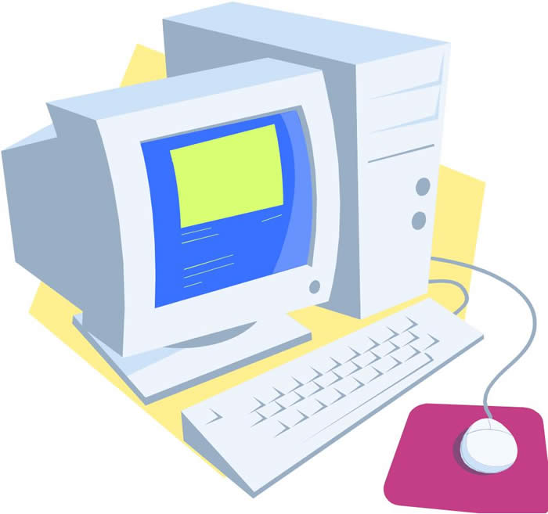
THE END

