Slide 2
Data Flow Diagram

Slide 4
Data flow diagrams
Data flow diagrams are used to consider data without bothering the equipment used to store it.
Four shapes are used for data flow diagrams and they are:

Slide 5
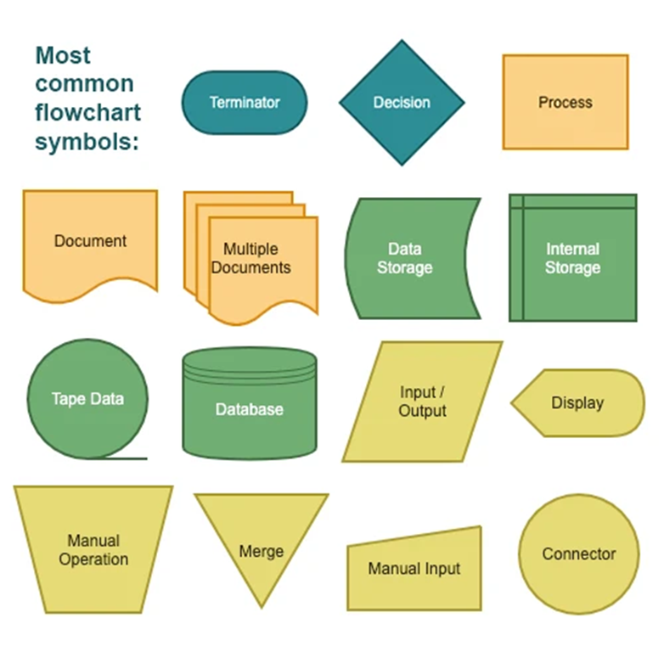

Slide 6
1. The box
The box is either a source of data such as an order form from a customer, or a part of the system which uses or consumes the data called a sink.

Slide 7
2. The sausage
The sausage shape is a shape used to represent a process which is done to data like calculation.
The process might be sorting the data or combining it with some other data. A brief description of the process should be placed inside the box.

Slide 9
3. The open rectangle
The open rectangle represents a data store. This is where the data is held. It could represent the data being held manually or on a computer. Basically a data store is a logical collection of data.
A description of the store can be placed inside the box.

Slide 10
4. The arrows
The arrows are used to show how the other symbols are connected.
For example:
The data flow diagrams for a system of a video library. The first diagram follows the data flow that takes place when a new member joins the library.
You can look at the data flow diagram for a video being added to the library.

Slide 11
This is a simple flow chart, with the details of the video, such as name, price, etc. being recorded and then stored.
We could, if we wanted to, join these diagrams together but it is much easier to draw them for each part of the system and then to draw a diagram with them all joined.

Slide 12
References

