Slide 1
Input Devices

Slide 2
Introduction
This presentation contains information about input devices. All of these devices are very useful and provide special data input facilities.

Slide 3
Keyboards
Keyboard is used to input letters and numbers and it also has special function keys.

Slide 4
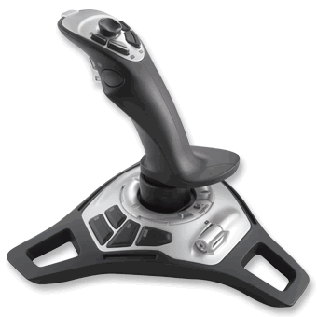
Joystick
Joystick is used for playing games such as flying games.

Slide 5
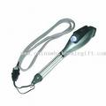
Light Pen
Light pen makes the user to draw directly on the computer screen.

Slide 6
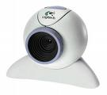
Webcam
Webcam takes the pictures into the computer and allow users to have video chats.

Slide 7
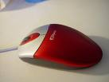
Mouse
Mouse allows user to select options quickly and drag objects around.

