Slide 3
HISTORY OF COMPUTERS
No one person invented the computer. There were many inventions over hundreds of years that led to the computers we know today.

Slide 4
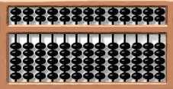
ABACUS
Thousands of years before the first electronic computer, people in china, the Middle East, and Greece used the abacus to add and subtract large numbers.

Slide 5
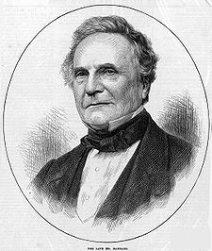
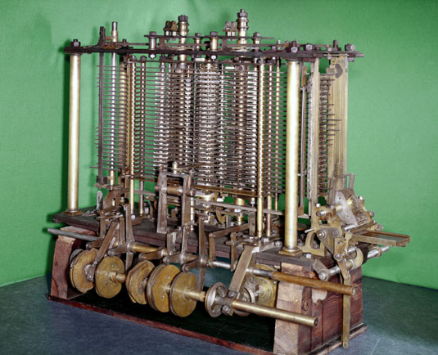
THE AUTOMATIC CALCULATOR
About 185 years ago in England, Charles Babbage invented an automatic calculator powered by steam. Although Babbage worked on his machines for many years, he was never able to build one that worked.

Slide 6
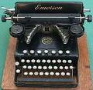
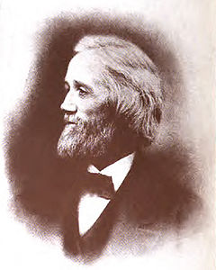
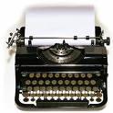
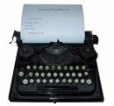
TYPEWRITER
About 135 years ago C. L. Sholes invented a typewriter. The computer keyboards we use today are based on the typewriter.

Slide 7
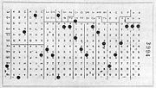
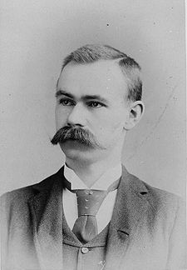
HERMAN HOLLERITH
About 155 years ago an American named Herman Hollerith invented a type of calculator. It stored numbers on punched cards. For more than 50 years, computers continued to use punched cards.

Slide 8
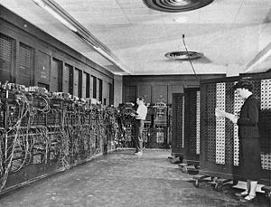
ENIAC
About 60 years ago a computer called the ENIAC was built in the U. S. T he computer was more than 80 feet long and weighed 30 tons. In 2 hours the ENIAC could do as much as 100 scientists could do in a year.

Slide 9
PERSONAL COMPUTERS
About 45 years ago personal computers were invented. These were small, desktop-sized machines. They were much less expensive than the other computers. Many people in offices, schools and homes began to use computers.

