Slide 1
Input Devices Grade -3

Slide 2
Types of Input Devices

Slide 3
Types of Input Devices
Here are some Input Devices that we can use in our computers
Mouse.
Keyboard.
Scanners.
Cameras
Microphones
Joysticks

Slide 4
Mouse
The Mouse is a device that is used to help us point at the computer screen.

Slide 5
Keyboard
The Keyboard is a device that is used to help us write.

Slide 6
Camera
The camera help us to capture images and display it on the monitor

Slide 7
Microphones
The microphone help us to record sounds and voices and for communication.

Slide 8
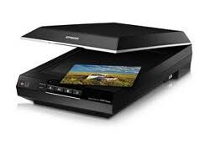
Scanners
The scanners are used to scan documents for printing and editing purposes.

Slide 9
THANK YOU!!

