Slide 1
Types Of Input devices

Slide 2
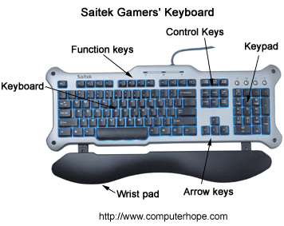
Keyboards
One of the main input devices used on a computer, a PC's keyboard looks very similar to the keyboards of electric typewriters, with some additional keys.

Slide 3
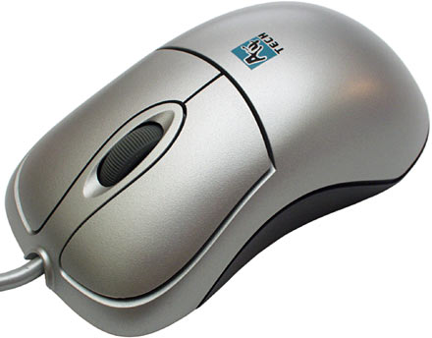
Mouse
The Mouse is a hardware input device that was invented by Douglas Engelbart in 1963.
The mouse allows an individual to control a pointer on the screen.

Slide 4
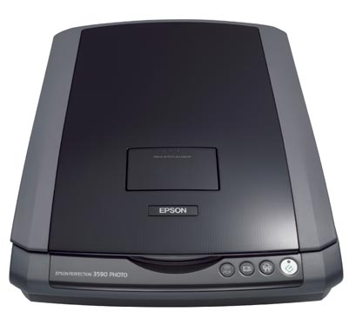
Scanners
Scanners are Hardware input devices that allow a user to take an image and/or text and convert it into a digital file, allowing the computer to read and/or display the scanned object.

Slide 5
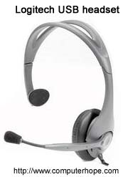
Microphone
Microphone is peripheral that Sometimes abbreviated as mic, a microphone is a hardware allows computer users to input audio into their computers.

Slide 6
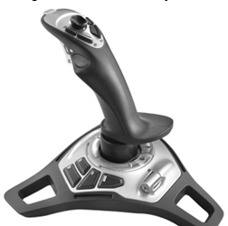
Joy stick
Joy stick is a peripheral input device that looks similar to a control device you would find on an arcade game at your local arcades.

Slide 7
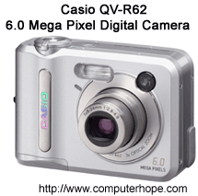
Camera
A type of camera which is considered to be another input device that stores the pictures or video it takes in electronic format instead of to film.

Slide 8

Webcam
A webcam is a type of camera connected to a computer or server that allows anyone connected to the Internet to view still pictures or motion video of a user.

Slide 9
References
http://www.computerhope.com
http://www.dce.kar.nic.in/new%20files/Chapter4-9-07.pdf
http://assets.cambridge.org/97805217/17649/excerpt/9780521717649_excerpt.pdf
http://en.wikipedia.org

