Slide 1
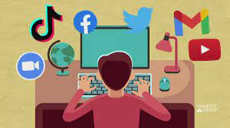
Internet

Slide 2
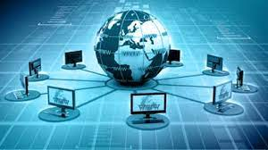
Internet is a network of computers around the world

Slide 3
People from around the world are connected to the internet can Share information very quickly

Slide 4
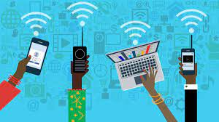
Business people use internet to do research, advertise and sell their products

Slide 5
E-mail is used to contact friends around the country and world

Slide 6
An e-mail address for school ends in with .edu

Slide 7
An e-mail address for government offices ends in with .gov

Slide 8
In the internet we can search using
keywords
AND or
OR

Slide 9
We can open a web page first opening the home page.

Slide 10
Open a web browser to run the internet in your computer

Slide 11
Every web page has a home page

Slide 12
We can click at the hyperlink to move around the web site

Slide 13
WWW
World wide web

Slide 14
URL
Uniform resource locator

Slide 15
Uses of Internet

Slide 16
Virtual museum field trip
We can visit a museum from our computer ,it is called as virtual museum field trip

Slide 17
E-mail
Electronic mail

Slide 18
Using internet people can share information very quickly around the world

Slide 19
World wide web is used to find information for school work or projects

Slide 20
Business people use the internet to do research, advertise and sell their products

Slide 21
Questions

Slide 22
What is the internet?

Slide 23
How can we use the internet?

Slide 24
Website for schools end in with..

Slide 25
Websites for government offices end in with…

Slide 26
Thank You

