Slide 1
Quizzes For Grade 3

Slide 2
_____________is information that is stored on a
CD-ROM, a DVD, or on the Internet.

Slide 3
Some programs let you mark CD-ROM pages so you can easily find them again. This is called as________________________.

Slide 4
We can sort database by name from_______________by clicking at

Slide 5
A__________________________ is an organized collection of data.

Slide 6
______________________________stores and sorts information.

Slide 7
________________ include games, stories and tools for painting and drawing.

Slide 8
A _______________________shows a demonstration of how something happens or how something works. Example- short movies

Slide 9
A _______________________teaches you or demonstrates how to use the program.

Slide 10
A __________________________ is a table used to work with numbers.

Slide 11
10___________________ and ____________________ can be made from spreadsheet.

Slide 12
1. A database consist of only fields but no records [TRUE / FALSE]

Slide 13
In database we cannot sort data [TRUE /FALSE]

Slide 14
3. A Database is an organized collection of data. [TRUE /FALSE]

Slide 15
4. Database software can only sort information but cannot store.
[TRUE /FALSE]

Slide 16
5. In spreadsheet it is possible to add new rows and columns.
[TRUE /FALSE]

Slide 17
6. In a spreadsheet a column and a row intersect is called a cell.

Slide 18
In a spreadsheet the data can be deleted by pressing delete key
or backspace. [TRUE / FALSE]

Slide 19
8. Click at UNDO button to bring back the deleted data in spreadsheet.
[TRUE /FALSE]

Slide 20
9. In a spreadsheet we can add, subtract, multiply and divide numbers.
[TRUE /FALSE]

Slide 21
10 . We can read, listen and play the information stored on CD-ROMS.
[TRUE /FALSE]

Slide 22
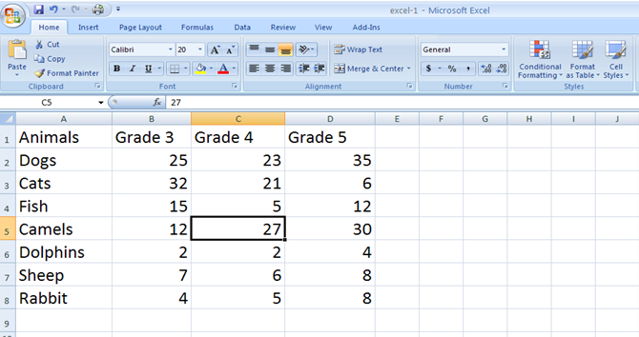

Slide 23
Q3. Complete the following instructions in the spreadsheet.
Fill active cell with green color
Fill cell B4 with red color
Fill cell A1 with blue color
Show rows in the spreadsheet
Show columns in the spreadsheet

Slide 24
Thank You

