Slide 1
Parts of a Computer

Slide 2
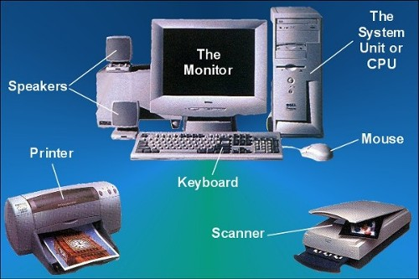

Slide 3
Computer is an Electronic machine
We have to give instructions to make it work

Slide 4
It consists of several parts such as :
Monitor
Keyboard
CPU
Mouse

Slide 5
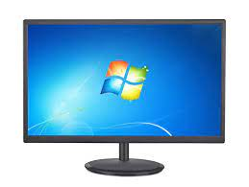
Monitor -Screen of the Computer It Displays the result as pictures ,text or numbers

Slide 6
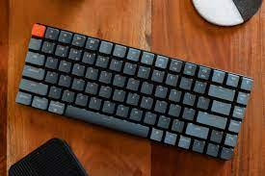
Keyboard Used for typing letters, numbers and other special characters

Slide 7
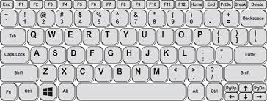

Slide 8
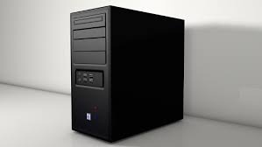
CPU Central Processing Unit

Slide 9
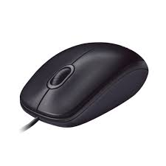
Mouse – It is used to select numbers, letters or pictures

