Slide 1
Types Of Computer

Slide 2
1. Desktops 2. Laptop Computer

Slide 3
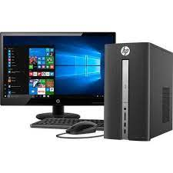
Computer Kept on a desk is known as “Desktop Computer”

Slide 4
It is also known as “Personal Computer” Or PC

Slide 5
Desktops are used
In Offices
At homes
In School libraries, etc

Slide 6
Laptop Computer
It is small Computer
It is like a notebook

Slide 7
Its used in
Offices
Meetings
Seminar

