Slide 1
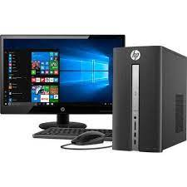
Uses of a Computer

Slide 2
Drawing Pictures

Slide 3
Typing Documents

Slide 4
Solving Sums

Slide 5
Listening to Music

Slide 6
Sending E-mails

Slide 7
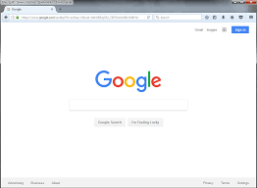
Browsing Internet
To get information

Slide 8
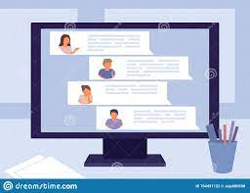
Chatting

Slide 9
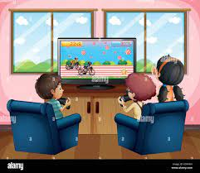
Playing games

