Slide 1
Computer Mouse

Slide 2
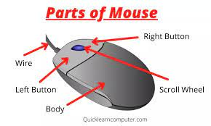
Parts of the mouse

Slide 3
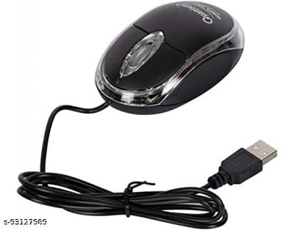
Types Of Computer Mouse
Wired Mouse

Slide 4
2. Wireless Mouse

Slide 5
Thank You

