Slide 1
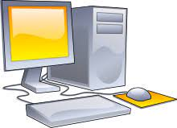
Places Computers are used

Slide 2
In School
Computer lab and classroom teacher use it to teach
To Keep Student records
In library

Slide 3
In Offices
To Keep documents
To Make bills
To type Documents

Slide 4
At Railway Stations
To Book Tickets
To get information about the arrival an departure of trains

Slide 5
At Airports
To Book Tickets
To get information about the arrival an departure of flights

Slide 6
In Banks
To maintain records of money
Depositing
Withdrawing

Slide 7
In Hospitals
To diagnose diseases
To maintain patient records

Slide 8
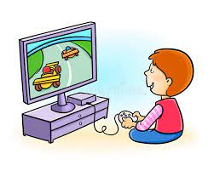
At Home
To Browse Internet
To play games
To listen to music
Watch movies

Slide 9
Thank you

