Slide 1
Input devices
Devices that are used to give information or commands to a computer

Slide 2
Keyboard
This Photo by Unknown Author is licensed under CC BY-SA

Slide 3
Webcam
This Photo by Unknown Author is licensed under CC BY-NC-ND

Slide 4
Scanner
This Photo by Unknown Author is licensed under CC BY-NC

Slide 5
Mouse
This Photo by Unknown Author is licensed under CC BY-NC

Slide 6
Joystick
This Photo by Unknown Author is licensed under CC BY

Slide 7
Gamepad
This Photo by Unknown Author is licensed under CC BY-SA

Slide 8
Microphone

Slide 9
Output devices
Output devices used to display results
Let’s learn about some of the output devices

Slide 10
Monitor

Slide 11
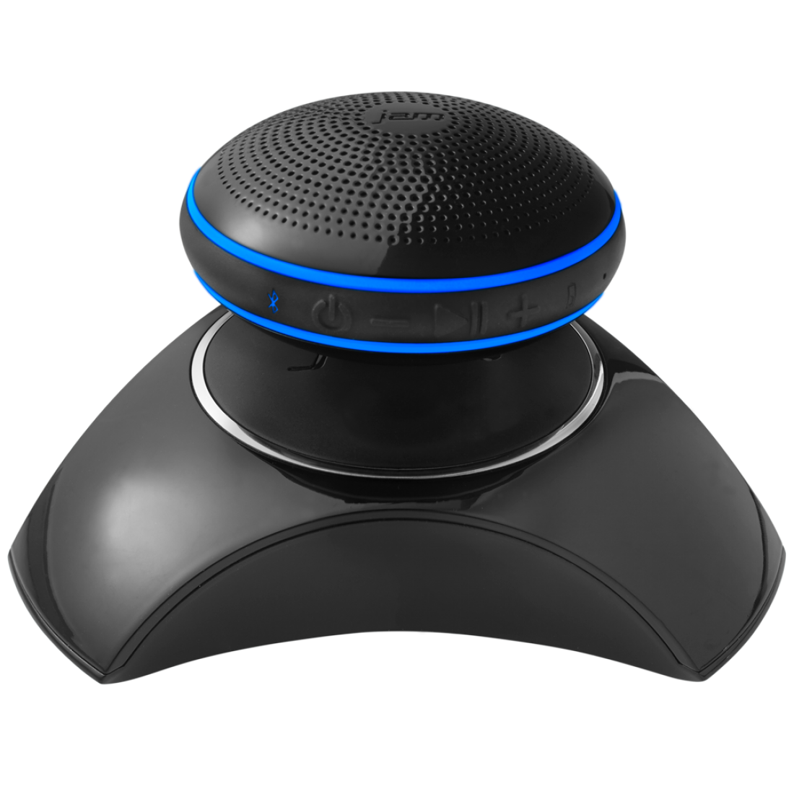
Speaker
This Photo by Unknown Author is licensed under CC BY-NC

Slide 12
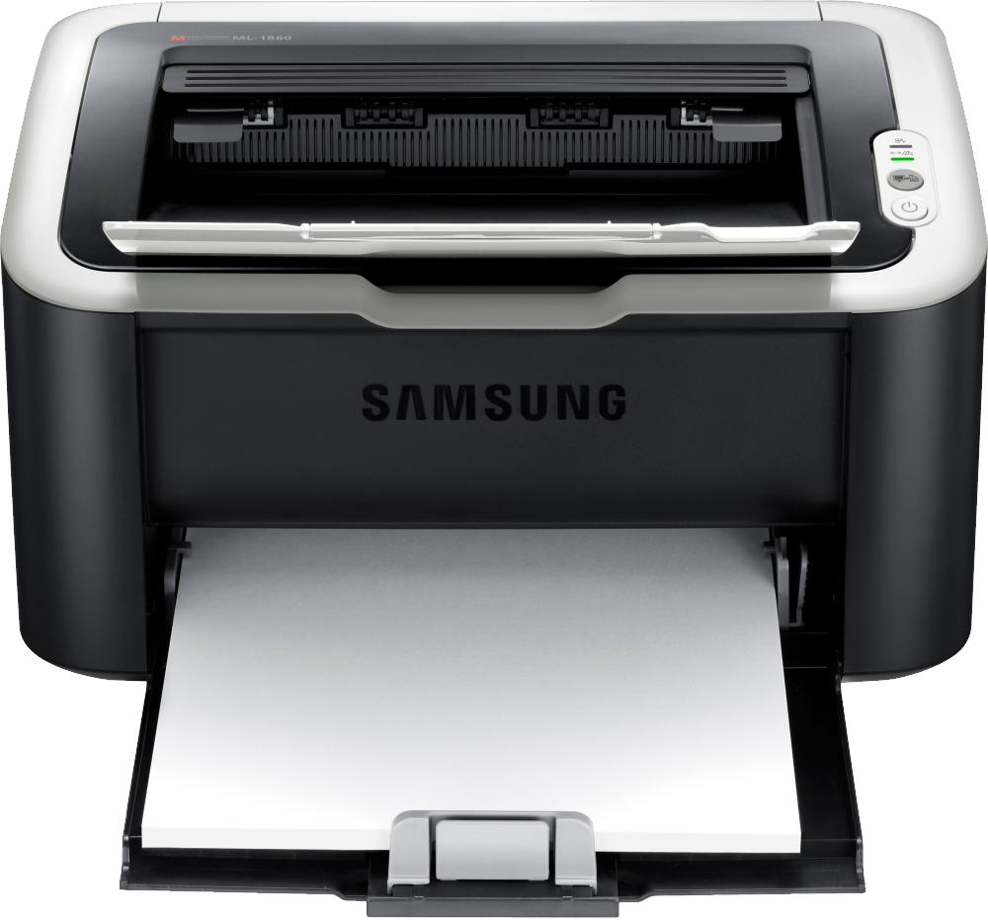
Printer
This Photo by Unknown Author is licensed under CC BY-NC

Slide 13
Some output devices also work as storage devices

Slide 14
External disk drive
This Photo by Unknown Author is licensed under CC BY-NC-ND

Slide 15
CD
This Photo by Unknown Author is licensed under CC BY

