Slide 1
Grade -1
Date :
Page No:

Slide 2
What do you see in the picture?

Slide 3
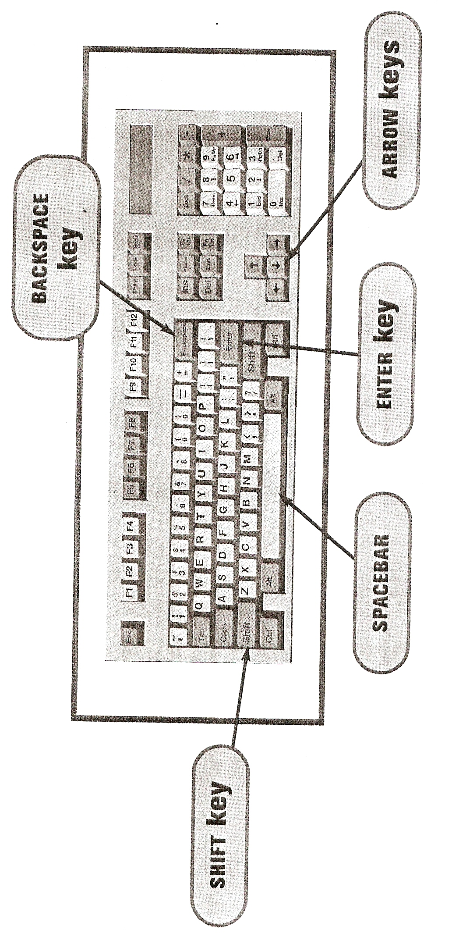

Slide 4
Let’s learn about a Keyboard

Slide 5
Keyboard is an input device

Slide 6
A computer keyboard is an input device that allows a person to enter letters, numbers, and other symbols (together, these are called characters)

Slide 7
Let’s learn about some of the keys on the Keyboard

Slide 8
Alphabet Keys

Slide 9
Alphabet Keys
These are 26 in number. Used to type letters and words

Slide 10
Number Keys

Slide 11
There are 2 sets of number keys on the keyboard

Slide 12
Enter Key

Slide 13
Enter Key is used to move the cursor to a new line
Enter Key is also used to end a paragraph

Slide 14
2 Enter Keys on the Keyboard

Slide 15
Spacebar Key

Slide 16
Spacebar
It’s the longest Key on the Keyboard
There is only spacebar on the Keyboard
Spacebar is use to insert a blank space between 2 letters or words

Slide 17
Backspace Key

Slide 18
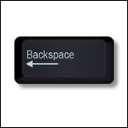
Backspace Key

Slide 19
It is used to erase that we type something incorrect
The looks like this
Arrow in the backward direction

Slide 20
Arrow Keys

Slide 21
Arrow Keys
There are 4 arrow Keys on the Keyboard
Arrow Keys are used to move the cursor up, down, right and left

