Slide 1
Parts of Computer

Slide 3
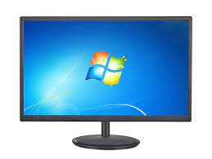
Monitor
It displays words and pictures. It is also called as Visual Display Unit(VDU)

Slide 4
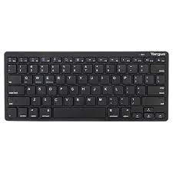
Keyboard
It is used to type numbers, letters and other symbols
Whatever you type it appears on the monitor
Keyboard has many button which are called as Keys

Slide 5
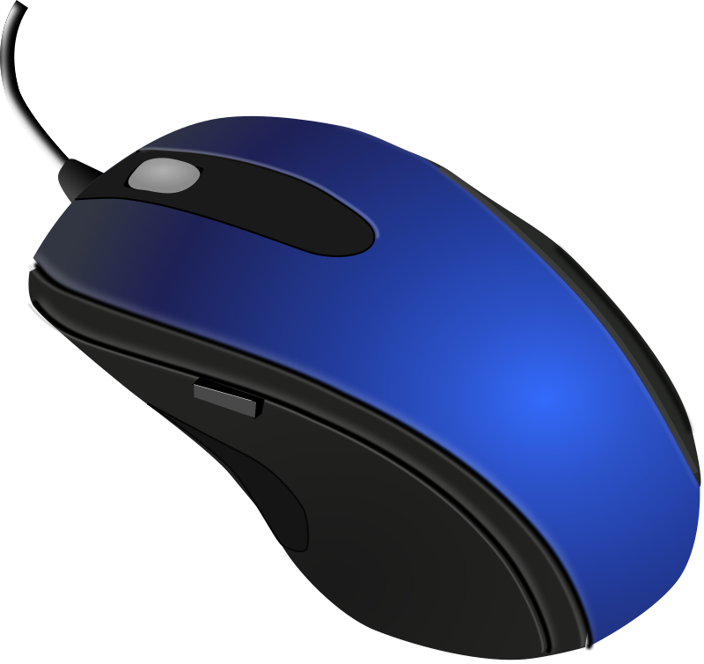
Mouse
It is used for pointing at things and drawing pictures on a computer.
Also used for selecting things on computer
This Photo by Unknown Author is licensed under CC BY-NC

Slide 6
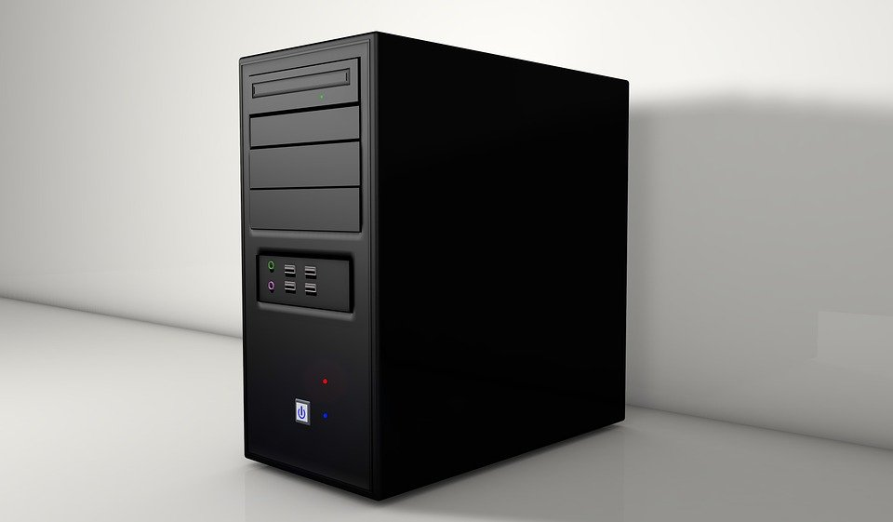
CPU
It is brain of a computer.
It’s the most important part of a computer
It processes the instructions and gives the result on the monitor

Slide 7
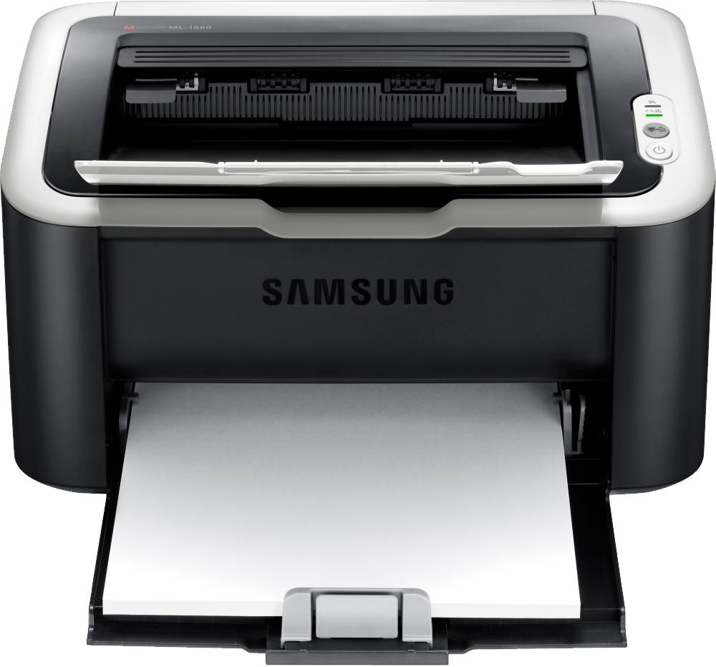
Printer
It is used to print things on paper that are shown on the monitor
This Photo by Unknown Author is licensed under CC BY-NC

Slide 8
Process of a computer
A computer is an electronic device that works on Input-process-output cycle
Input --→process ----→ output

