Slide 1
Storage Devices

Slide 2
Storage Device
A storage device is a hardware that is used to store data and other information

Slide 3
Data
Data is a fact or figure stored in computer system

Slide 4
Data
Data is stored either temporarily or permanently

Slide 5
Types of storage Devices
There are 2 types of storage devices
1. Internal Storage Devices
2. External Storage Devices

Slide 6
Internal Storage Devices
It is stored inside a computer system
Also called as
1. “Primary Memory” of a computer
2. Popularly called as ‘RAM’
Random Access Memory

Slide 7
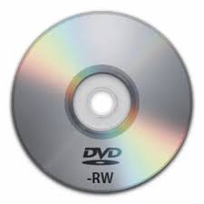
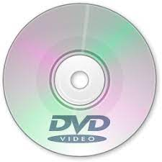
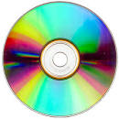
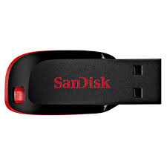
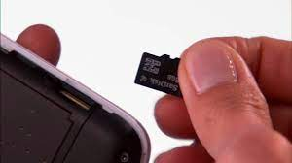
External Storage Devices

Slide 8
External Storage Devices
These devices store data outside the computer system
These devices are also called as ‘Secondary Memory’

Slide 9
Compact Disc (CD)
CD is a portable storage device
Used to stored text , audio and videos

Slide 10
Digital Versatile Disc DVD
It has more capacity to store data than CD
Also called as secondary storage device

Slide 11
Pen Drive
It’s popularly called as USB
OR thumb drive
It has more capacity data – upto 64 GB

Slide 12
Data Card
Used to store audio , video and data files
Stores data permanently

Slide 13
Data card used in ‘Smart Phones’
It increases the storage capacity of
‘smart phones’

