Slide 1
Types of Computers

Slide 2
Lets learn different Types of computers

Slide 3
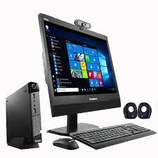
Desktop computer
It is kept on the desk
It is big in size
Difficult to carry

Slide 4
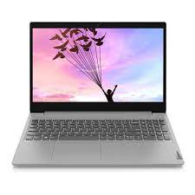
Laptop
It can be kept on lap
Smaller in size
Easy to carry

Slide 5
Palmtop
Its very small in size
Fits into our palm
Can be easily carried in our pockets

Slide 6
Palmtop

Slide 7
Well Done !!!

