Slide 1
Input Devices
IGCSE

Slide 2
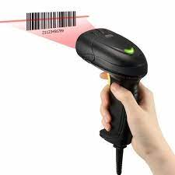
Barcode Reader
Scans in barcodes from products

Slide 3
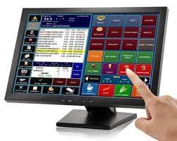
Touch screen
Allow choices to be entered
Type of Products or Price of an item

Slide 4
Keyboard or Keypad
We can enter number of items, we can use to enter barcode number when barcode fails to scan

Slide 5
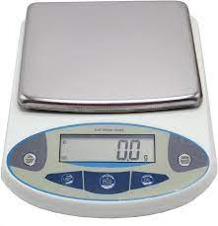
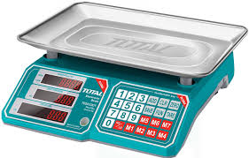
Electronic Scales
Automatically enters weight of items like fruits, vegetables etc

Slide 6
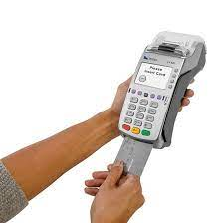
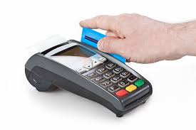
Chip or PIN reader
Allows customers to pay for their goods using cards

Slide 7
Thanks folks

