Slide 1
Output devices
Marks -4

Slide 2
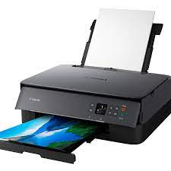
Printer
It helps to produce bills at the cash counter of the customers

Slide 3
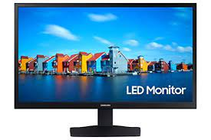
Monitor
Shows the output like Number of items

Slide 4
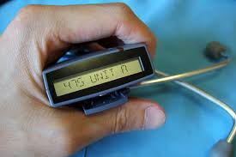
Beeper
Reads barcode if its correct
Or else
Gives error is barcode fails to scan

Slide 5
Thanks

